Slide 1
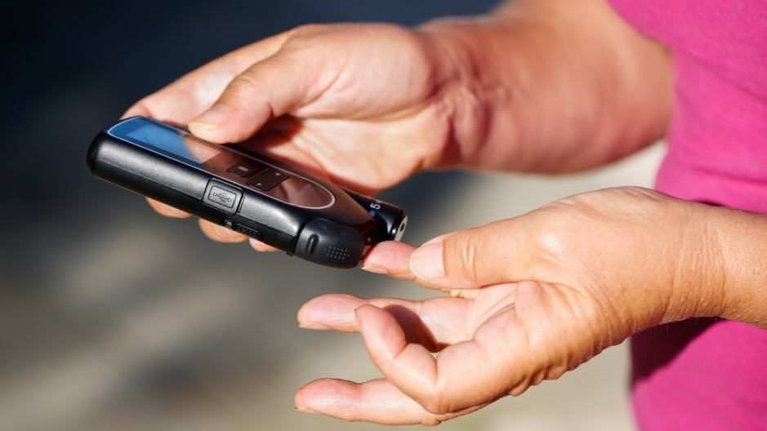
Diabetes Prioritized Molecules
Top Five Molecule Analysis For US Market

Slide 2
Executive Summary
USA Top Diabetes Product Market 2020-21 in a Nutshell
USA METFORMIN MARKET
by Volume
10,000t
by Value
~ $62m
by Volume
1331KT
by Value
13.5M
Growth rate
2015-2020
81%
USA GLIPIZIDE MARKET
by Volume
10,000t
by Value
~ $62m
by Volume
434 MT
by Value
200.4M
Growth rate
2015-2020
318%
USA METFORMIN HCL
&
PIOGLITAZONE MARKET
by Volume
10,000t
by Value
~ $62m
by Volume
42.7MT
by Value
7.3M
Growth rate
2015-2020
14%
USA METFORMIN HCL
&
GLIPIZIDE MARKET
by Volume
10,000t
by Value
~ $62m
by Volume
7.2 MT
by Value
1.7M
Growth rate
2015-2020
150%
USA METFORMIN HCL
&
GLIBENCLAMIDE MARKET
by Volume
10,000t
by Value
~ $62m
by Volume
83.2MT
by Value
3.12M
Growth rate
2015-2020
43%

